Slide 1
Is it worth the time?
Buying time by automating your life

Slide 2
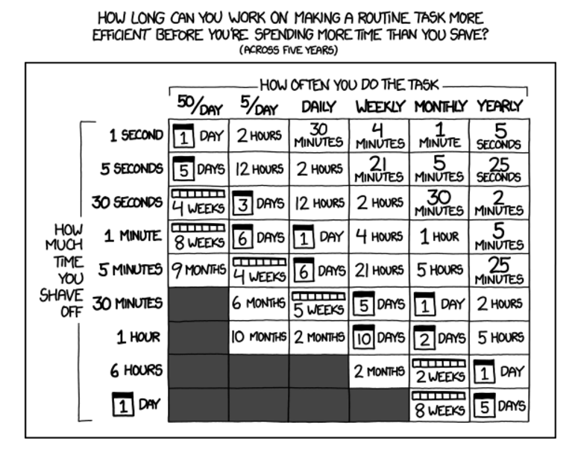
Notes:
We all know automation is a good thing, the problem is sometimes it’s just not worth automating some tasks because the time it takes to build the automation outweighs the cost savings by automating. This is exemplified by this well known comic from XKCD.

Slide 3
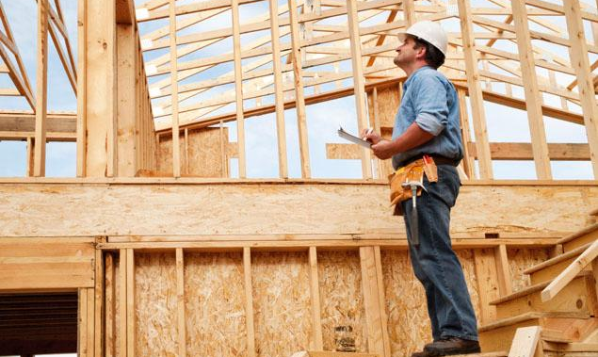
Notes:
They say a builders house is never done. This is especially true for software developers. It’s fun building stuff but the goal here is to _buy time_.

Slide 4

Notes:
Even if you were to build the automation, what about the hidden costs?
Time it takes to learn a new API
Time it takes to implement the automation
Maintenance cost; 3rd parties are continually updating their APIS – sometimes with breaking changes.
Downtime; these automations become a staple part of your life and they need to be dependable.

Slide 5
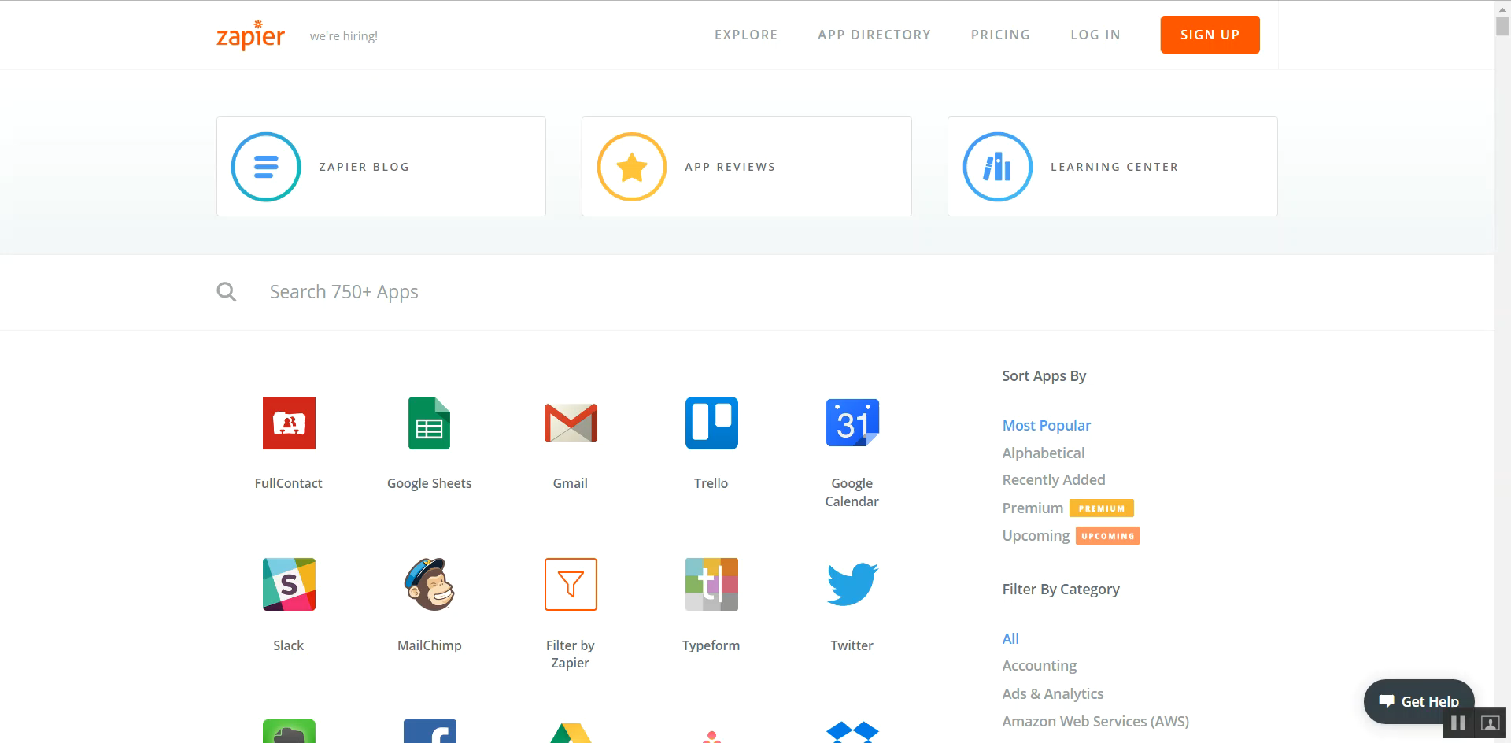
Notes:
I use Zapier because it has the most integrations and the user interface is great. There are other products in the market
IFFT targets consumer – limited integrations in comparison
Microsoft Flow – was only just launched recently which means the competitors have a head start. Right now Flow’s integrations are pretty much non-existent in comparison.

Slide 6

Notes:
You can buy time with money.

Slide 7
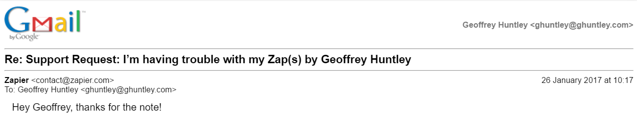
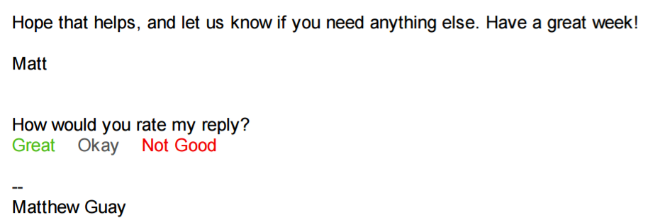
Notes:
- If you run into a problem or a question; you can outsource your concern!

Slide 8
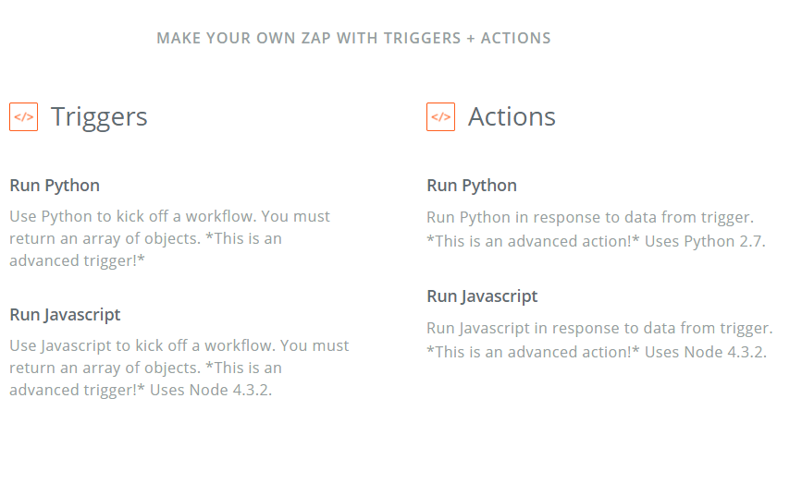
Notes:
- With Zapier, you can also write your own integration using nodejs or python and Zapier will host it for you. That means you are not locked into a product roadmap – embrace what they provide by default and extend it with your own logic until the roadmap catches up.

Slide 9
this slide left intentionally blank

Slide 10
Weekly Xamarin

Slide 11
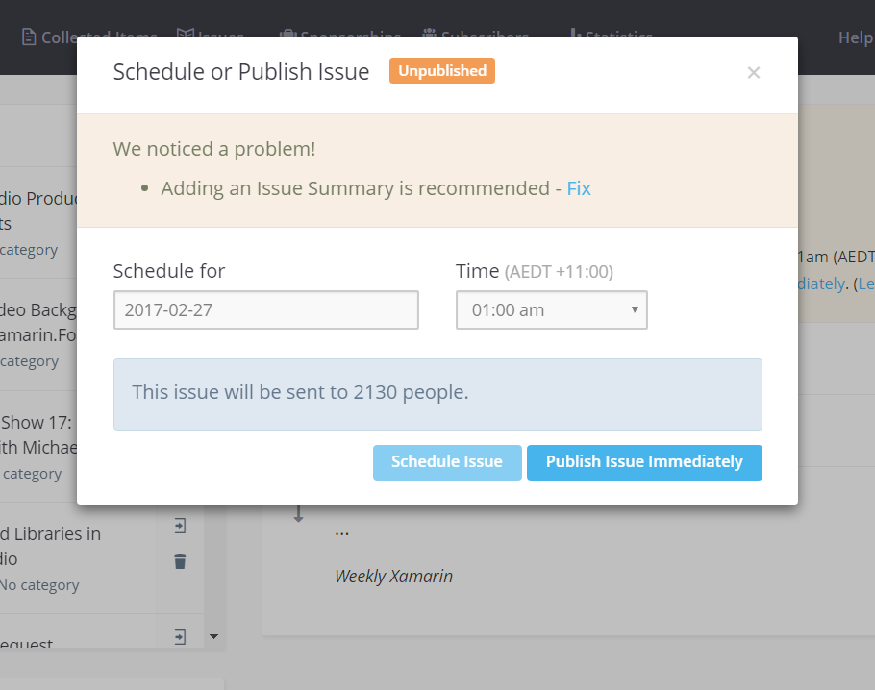
New Edition
Notes:
Every week, I scourge RSS feeds, twitter and other sources to curate content for the weekly newsletter.

Slide 12
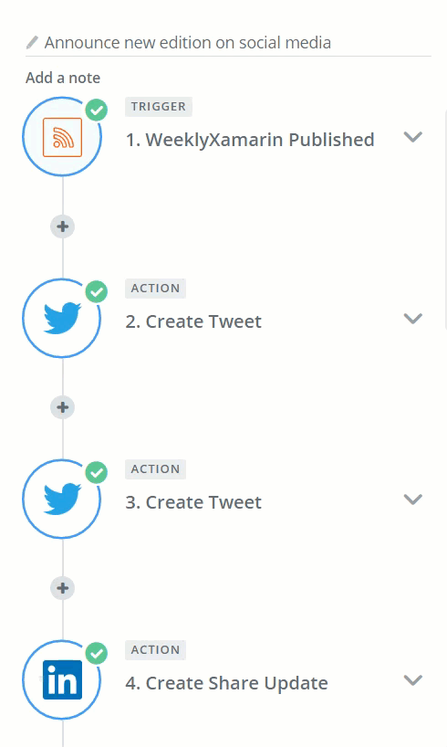
New Edition
7 automations
Notes:
Once the newsletter was ready to go out the door, there were seven marketing tasks that were manual.

Slide 13
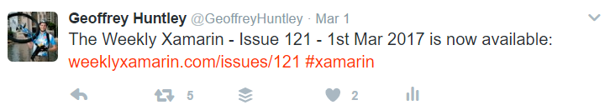
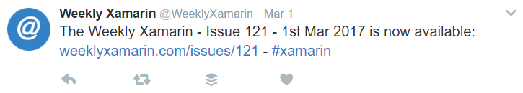
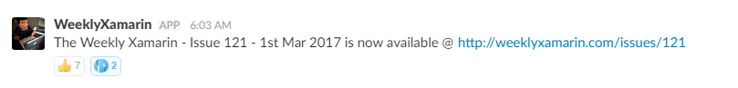
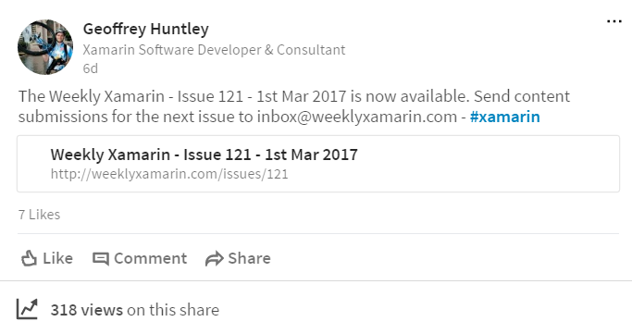
New Edition
Twitter x 2
LinkedIn x 1
Facebook x 1
Slack x 3
Notes:
Opening up notepad, typing up the copy and then manually pasting into
Two twitter accounts – login/logout
LinkedIn
Facebook Pages
Three Slack instances.
I now look forward to pressing the “Publish Edition” button. The feeling is very similar to CI/CD with automatic blue-green deployments.

Slide 14
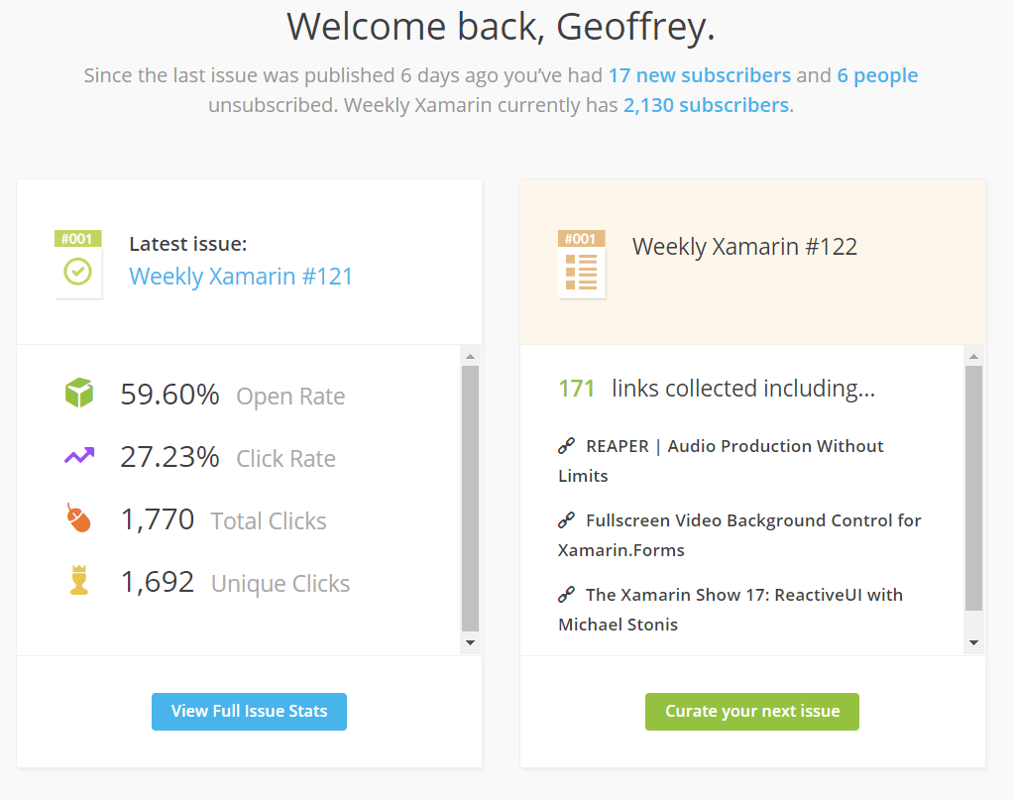
Curation
Notes:
Curating of content for the newsletter is something that takes considerable amount of time. The newsletter is a newsletter, not a listing of links and as such editorial was taking quite some time.

Slide 15
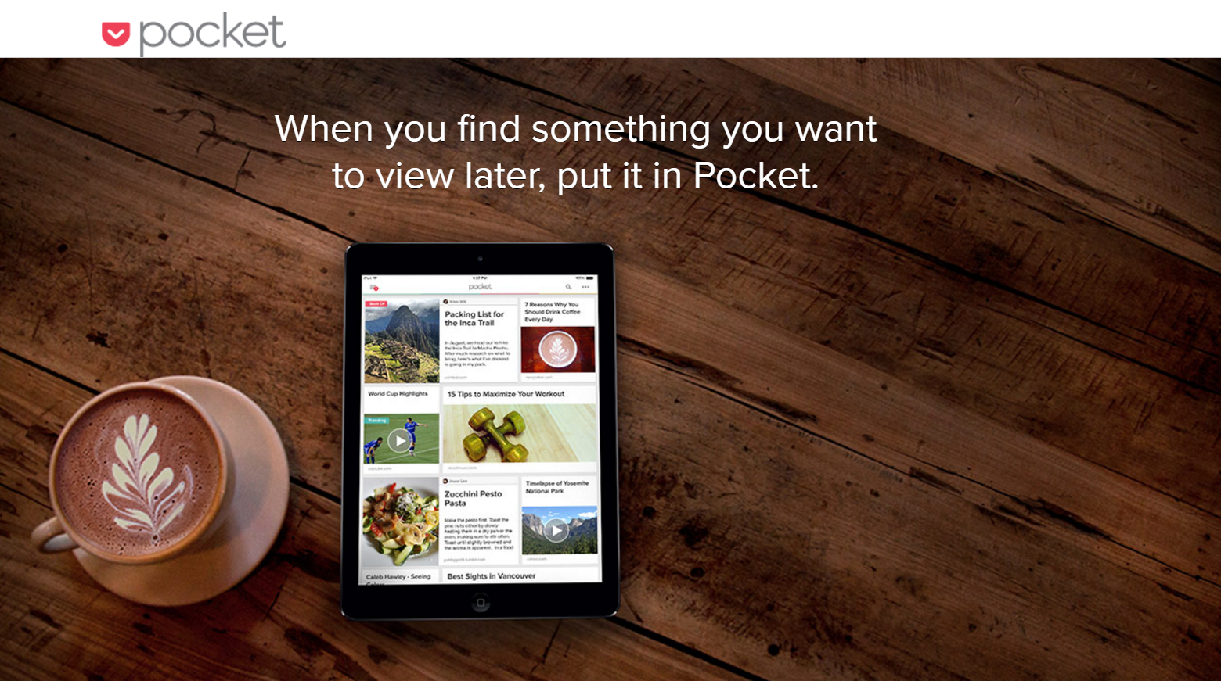
Curation
Automatically summarizes content
Notes:
Each item in the newsletter has hand written commentary. In the early days I was doing it all by hand, now I use a SaaS platform to automatically generate the baseline copy which I then customize so the tone and voice is consistent through-out the edition.

Slide 16
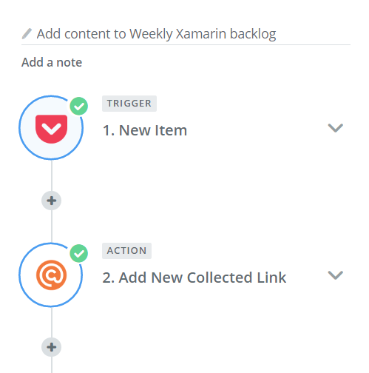
Curation
Simple automation yields hours saved per week
Notes:
This simple automation of “When content is added to pocket, add it to the Kanban backlog” saves me at least five hours per week. When I stumble upon something interesting from my phone all I have to do is tap “Share -> Add to Pocket” and Zapier does the rest.

Slide 17
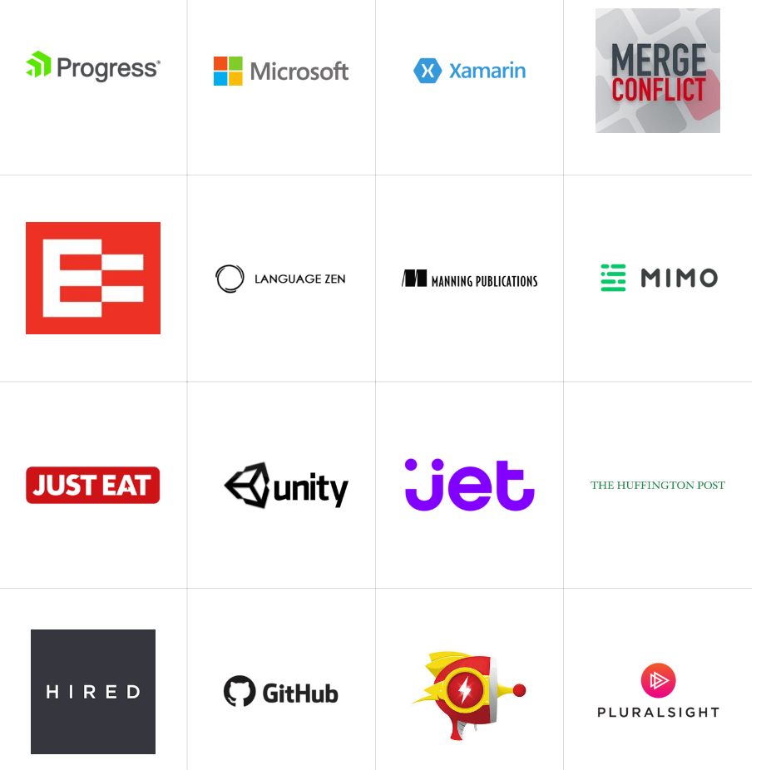
Sponsorship
Notes:
Last year I split my business finances away from my personal finances, with one goal in mind. Any hobbies must be self-sustaining. So far efforts have been moderately successful. It’s been a great way to learn basic book keeping and re-learn just how much time sales takes.

Slide 18
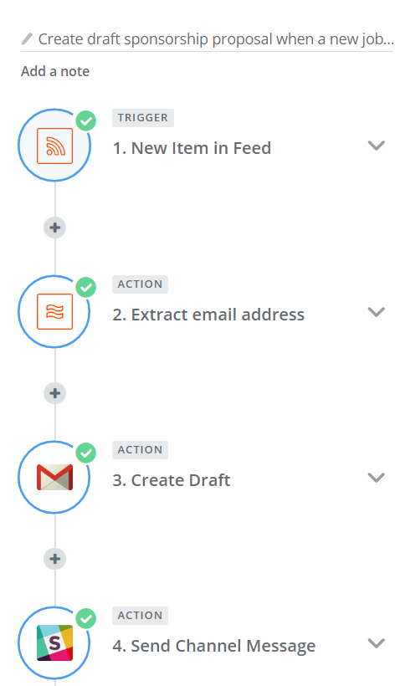
Sponsorship
Automatically create draft email proposal
Notes:
After doing sales manually for a while I found that the majority of the process could be automated.

Slide 19
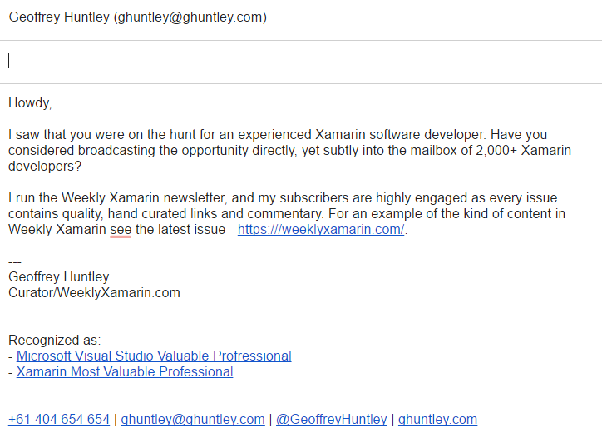
Sponsorship
Manual review process to qualify the lead and to tweak copy
Notes:
When a lead is identified a draft email is automatically created in my inbox and a lead is automatically created. I manually review the opportunity to ensure the lead is qualified and then customize the copy as needed.

Slide 20
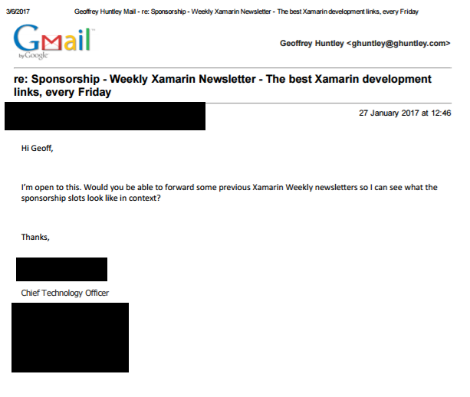
Sponsorship
A single conversion covers the cost for the curation SaaS platform for many months.
Which saves more time because it removes the temptation to re-implement the SaaS platform.
Notes:
And it works…. A single conversion covers the cost of the SaaS platform and Zapier for many months. It also has the added benefit of removing the friction of paying of the email platform which creates frictions as some basic features that would save me even more time are missing.

Slide 21
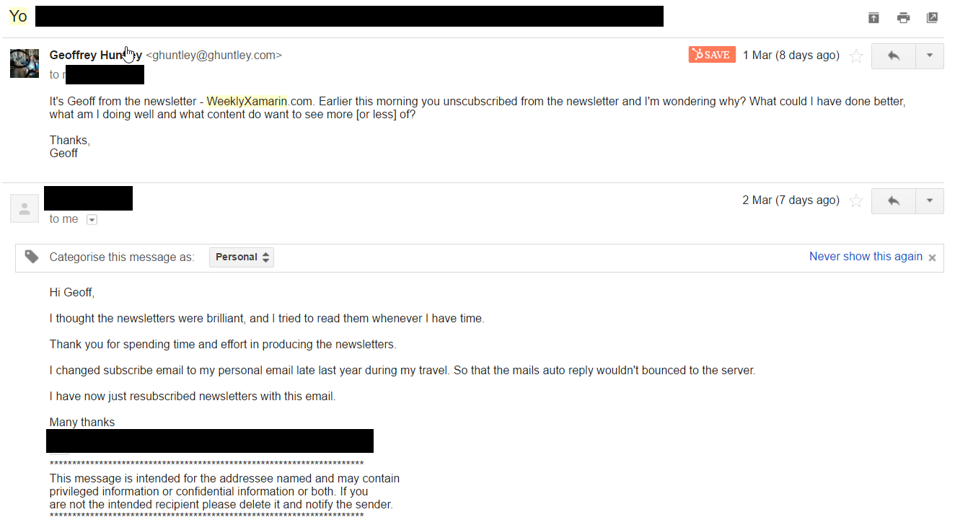
Retention
Attrition is death
Do you understand or measure it?
What content is missing? What should there be more or less of?
Opportunity to collect insights into developers movements between ecosystems.
Notes:
Attrition is death. Every time a new newsletter goes out there are always people who unsubscribe. Some of it natural and some of it unnatural.
I used to email every unsubscriber manually but now that initial question email is automatically sent the next morning at a random time.
It is critical to understand and measure it. What content is missing, what should there be less of? It’s also an opportunity to collect insights to developers thoughts about Xamarin – are they happy with the tool or are they moving on and to what?

Slide 22
Retrospective

Slide 23
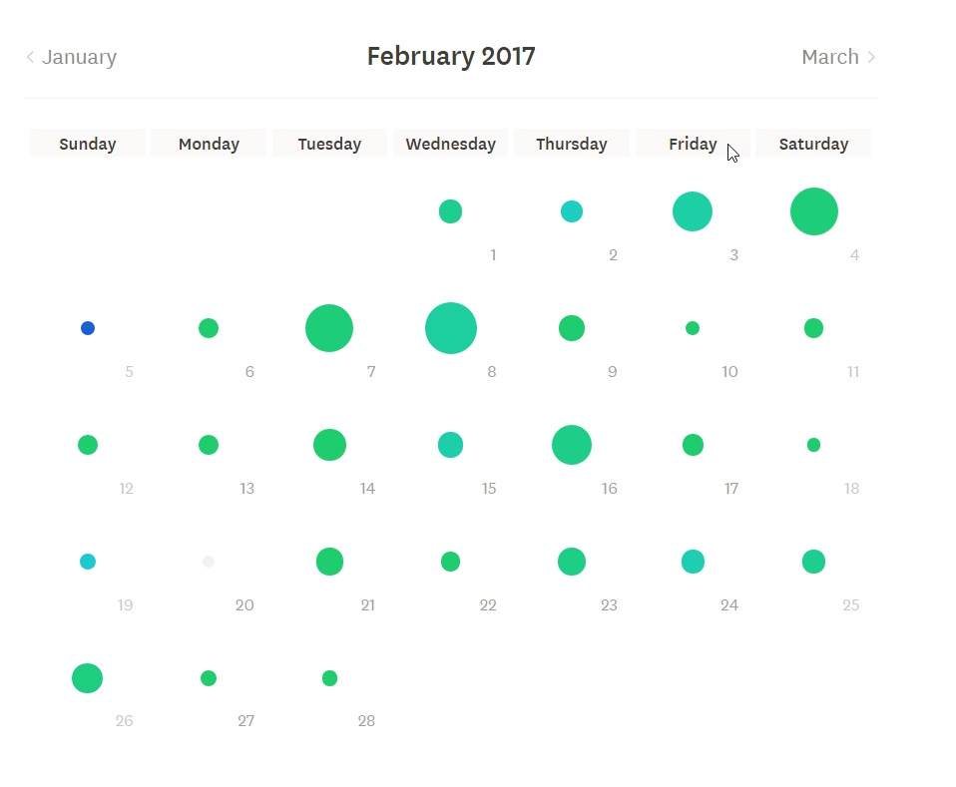
iDoneThis.com
*Everything* aggregates into iDoneThis:
Nerdsniped on GitHub or Twitter.
Open or merged GitHub pull-request.
Open or closed GitHub issue.
Weekly Xamarin released.
Sent an email.

Slide 24
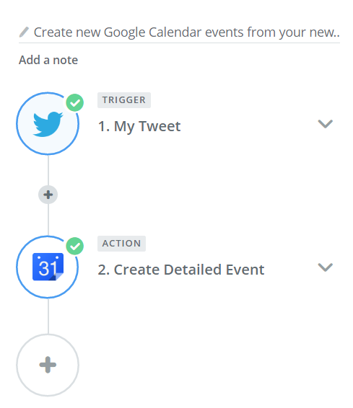
Twitter

Slide 25
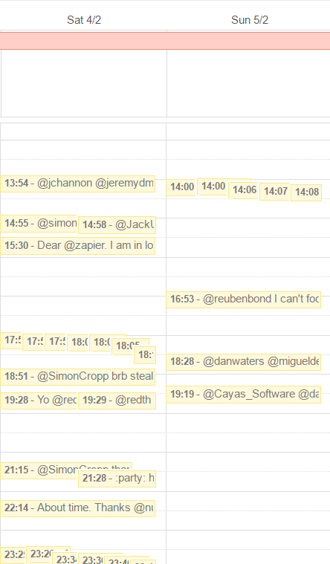
Twitter
Fantastic source of insight into routines. Useful indicator.
Separate calendar which can be toggled on/off functions as an overlay of day-to-day events.

Slide 26
Open Source

Slide 27
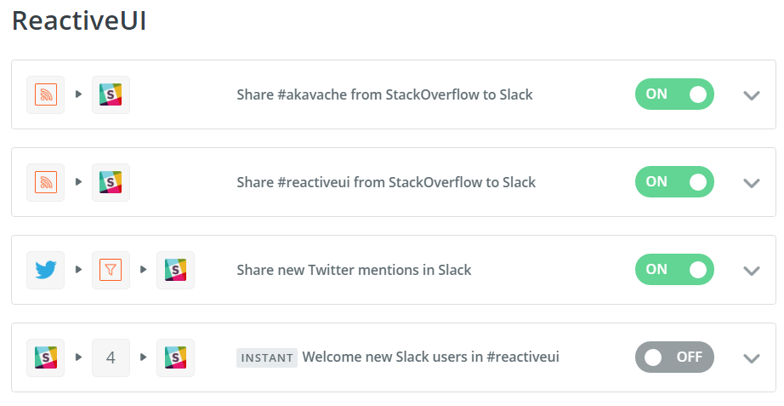
Open Source
Improved response times to Twitter interactions.
Improved response times to StackOverflow questions.
Reduces amount of technical questions of “How do I” in Slack which prevents old-timers from burning out.

Slide 28
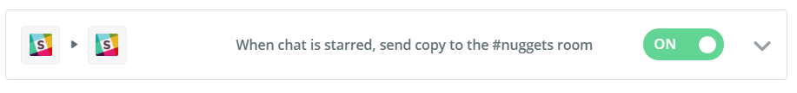
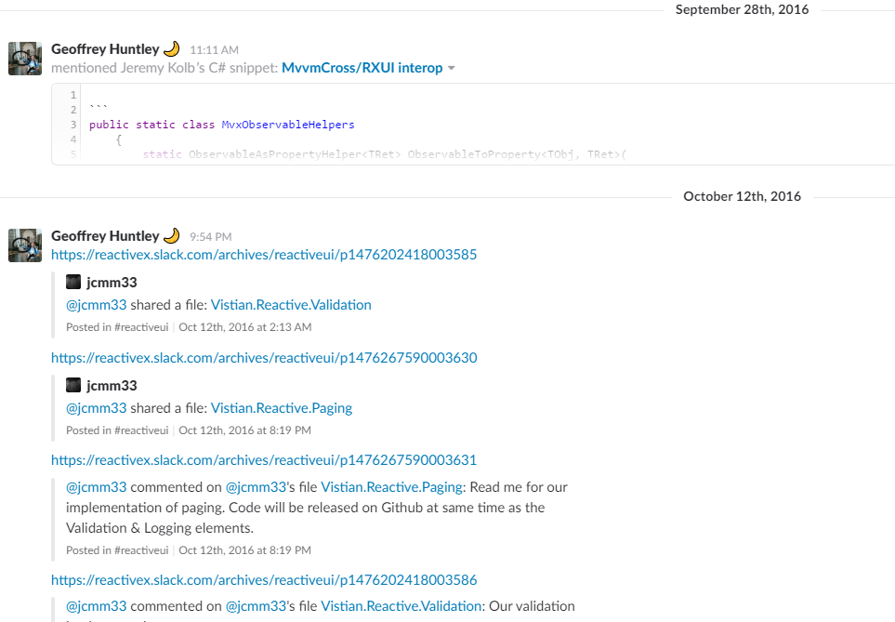
Open Source
Automatically adding nuggets of knowledge into the project documentation backlog TODO

Slide 29
Marriage

Slide 30
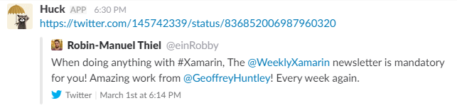
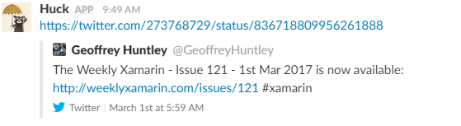
Twitter
Automatically share important milestones.
Routines - Has the newsletter gone out? Useful leading indicator.

Slide 31
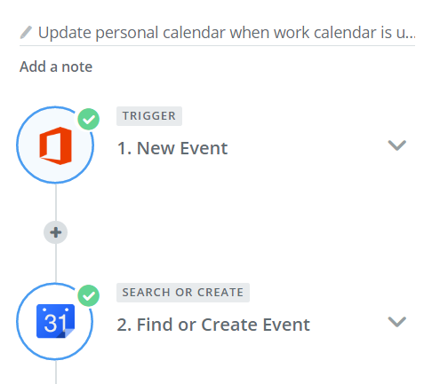
Calendars
Automatically sync work appointments entries into personal calendar.

Slide 32
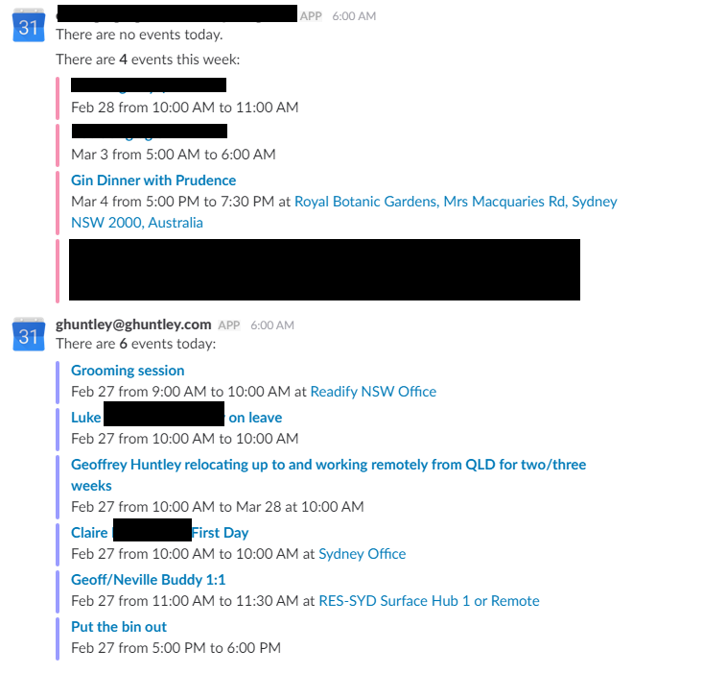
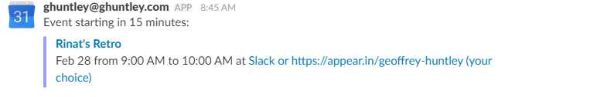
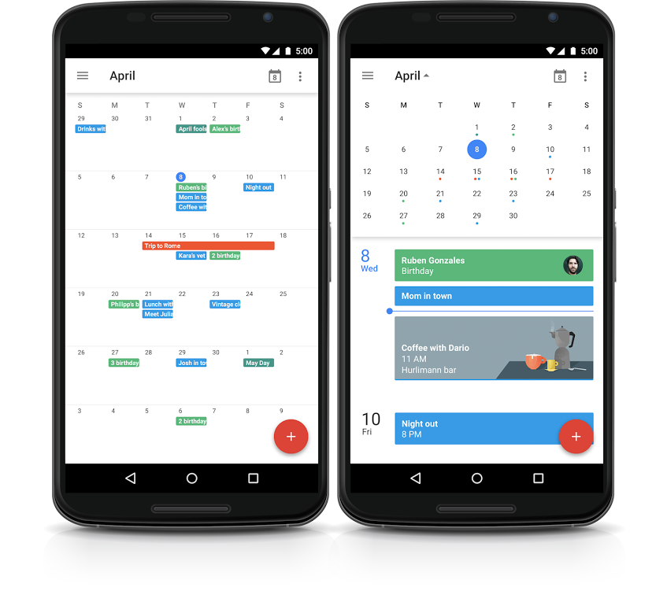
Calendars
When is the best time for Erin to call me?
Automatically let Erin know of out-of-hour work commitments
Visible on her home screen.
Visible in the morning stand-up.

Slide 33
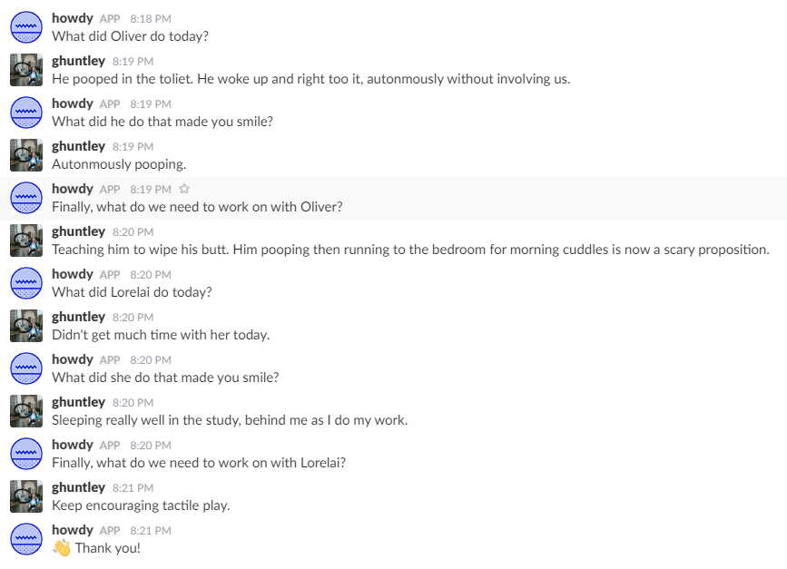
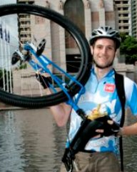
@GeoffreyHuntley

